Slide 1
Deep learning using GAN {Gyan of GAN}
By Vishakha Ghabroo and Srikari Rallabandi

Slide 2
OBJECTIVE
In this project -- we intend to understand, train, and implement a GAN on MNIST (handwritten digits dataset) to generate digit images that look like handwritten digit images from MNIST, which could be used to train other neural networks.

Slide 3
WHAT IS GAN?
Two competing neural networks in a zero-sum game framework.
What can it be trained to do?

Slide 4
1.Components:
Generator network
Discriminator network
2.Training:
The generator – fool the discriminator
discriminator – correctly identify real and fake data.

Slide 5
APPLICATIONS OF GAN
Image synthesis
Text-to-Image synthesis
Image-to-Image translation
Anomaly detection
Data augmentation

Slide 6
STEPS OF IMPLEMENTATION
MNIST (database)
Generator
Discriminator
GAN
Training
Testing the Generator

Slide 7
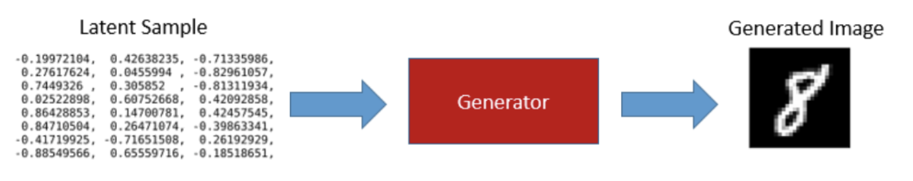
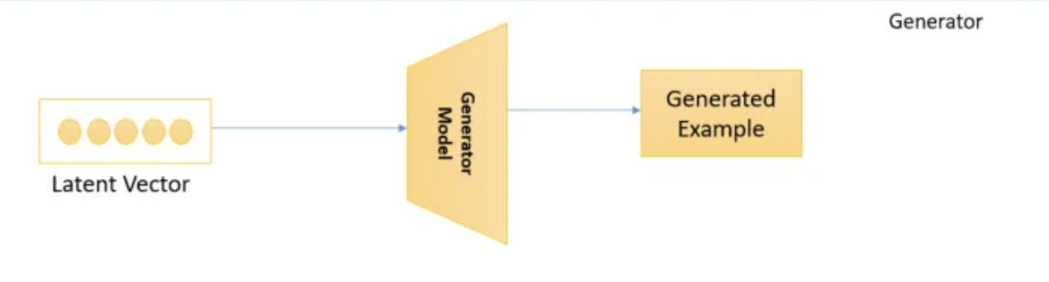
GENERATOR

Slide 8
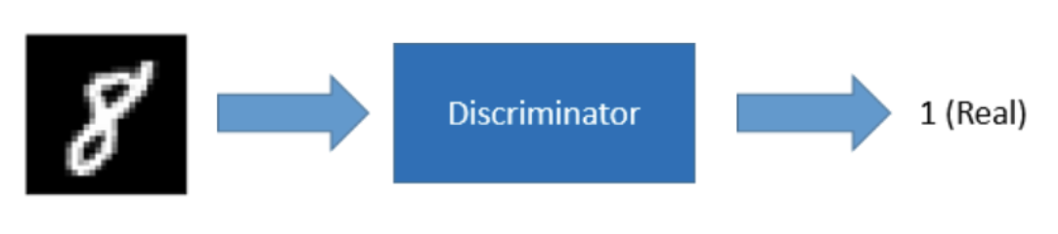
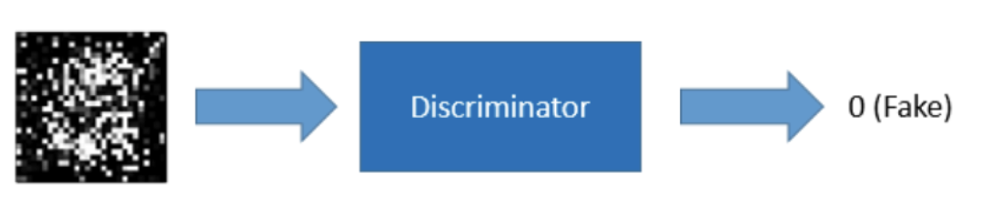
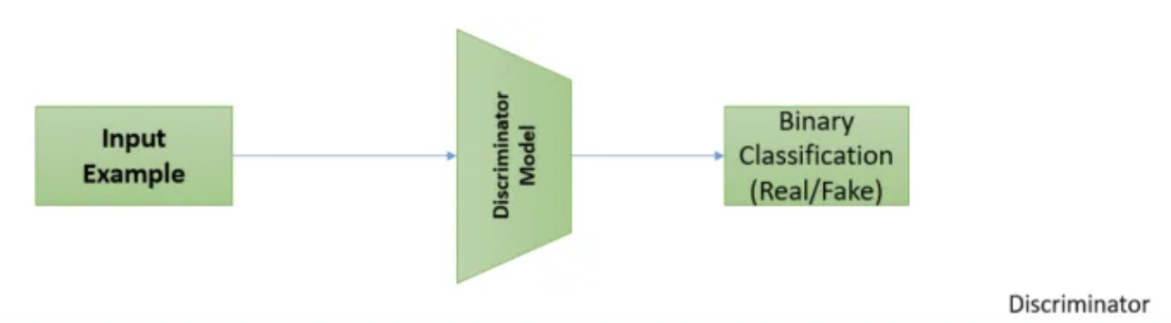
DISCRIMINATOR

Slide 9
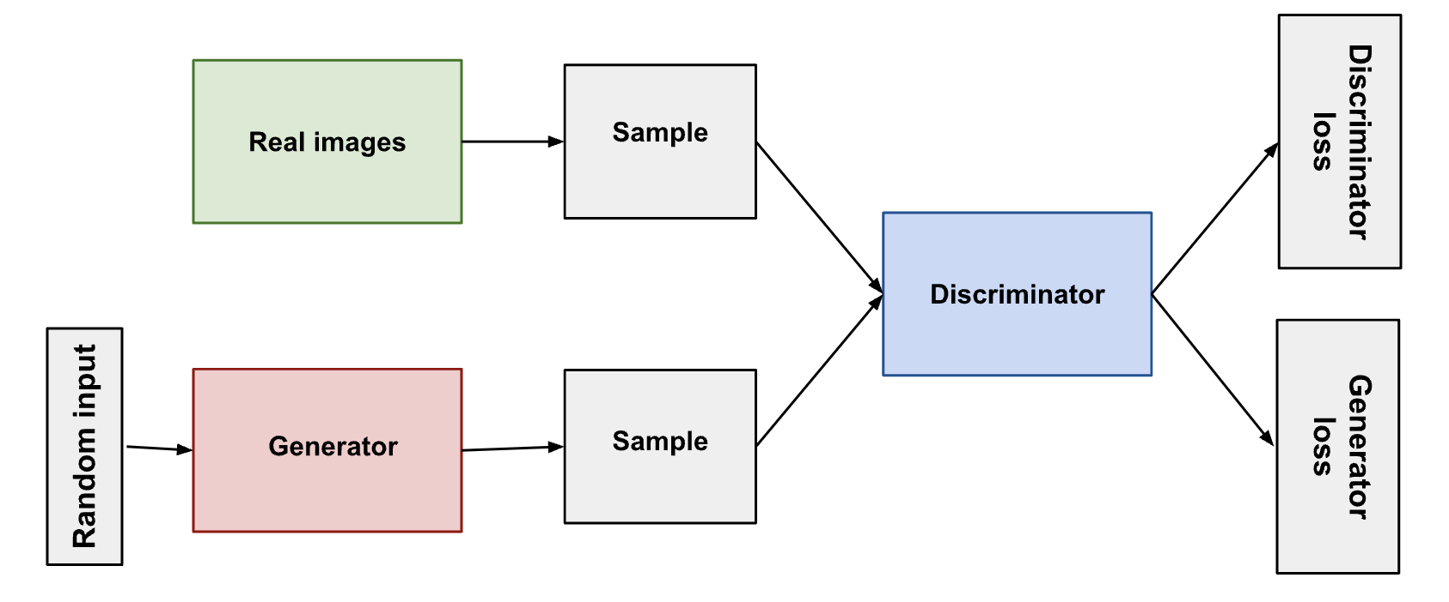
GAN

Slide 10
TRAINING GAN
Preprocessing
Deprocessing
Labels
Label Smoothing
Training Loop
Stabilizing GAN

Slide 11
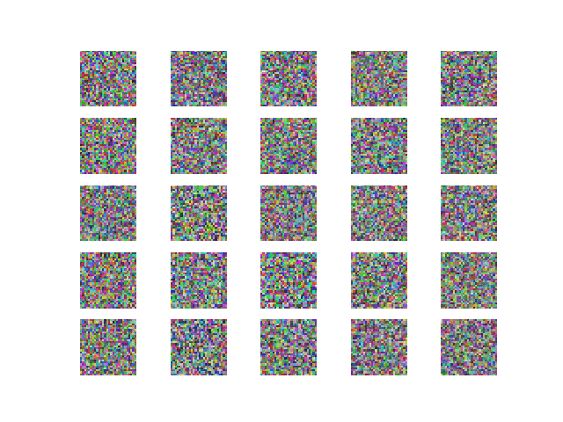
Adam as a optimizer
What is adam?
Why do we use it?

Slide 12
LIBRARIES USED
Keras
Adam {as optimizer – keras.optimizers}
LeakyReLU,
BatchNormalization
Matplotlib
Sklearn.model_selection (train_test_split)
numpy

Slide 13
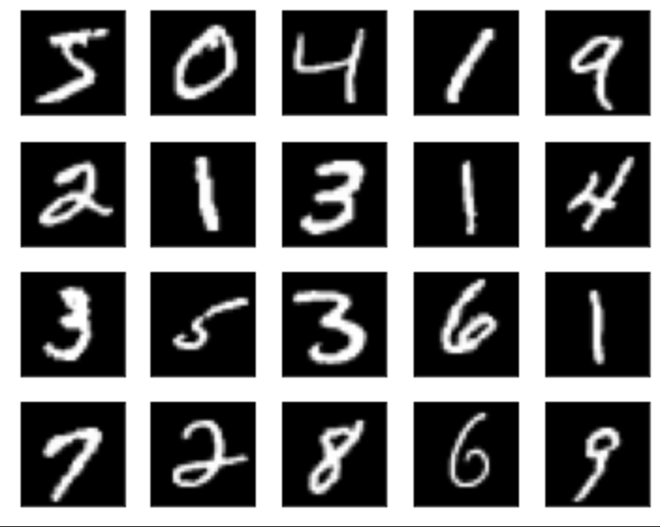
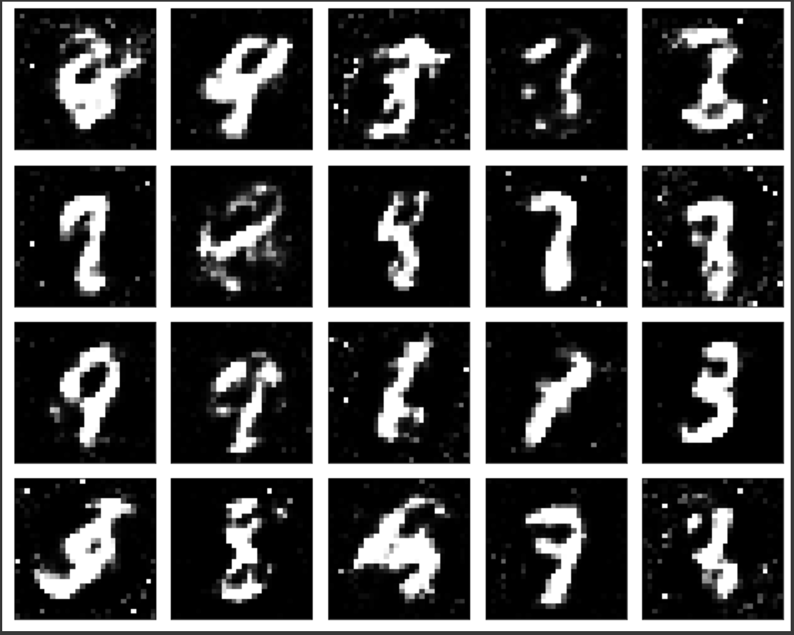
INPUT AND OUTPUT

Slide 14
FUTURE SCOPE AND WHAT WE LEARNED
DCGAN
What is GAN
Implementing GAN
Understanding (and appreciating) the procedure – (the effect of ‘epoch’)
GAN’s impact in various fields – FinTech, entertainment etc.

Slide 15


